Slide 1
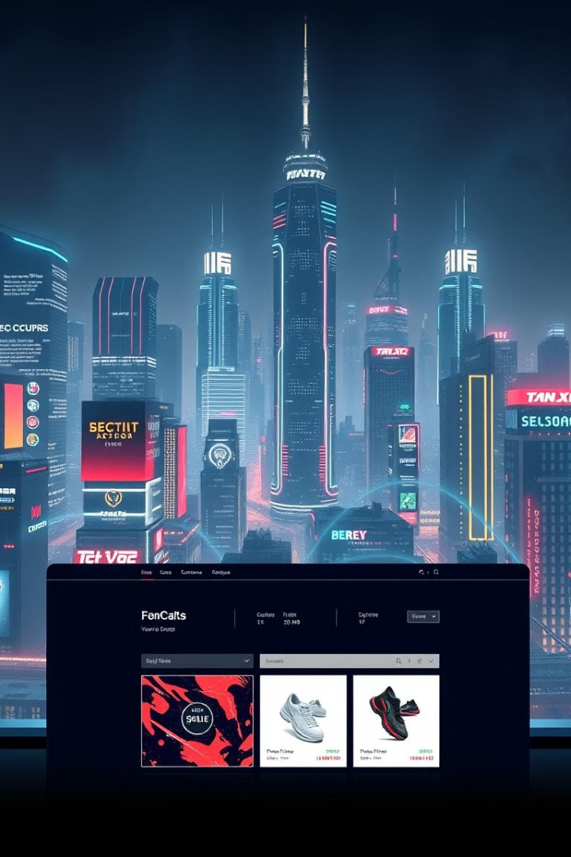

NextGenTech: Revolutionizing the Electronics E-Commerce Experience
Introducing NextGenTech: Your one-stop destination for cutting-edge electronics and gadgets. Addressing the frustrations of modern online shopping through innovation and user-centric design.

Slide 2
AI-Powered Personalized Recommendations
Choice Overload
AI-Powered Recommendations
The average consumer spends 15 minutes searching for the right product on typical e-commerce sites.
Powered by machine learning algorithms analyzing browsing history, purchase patterns, and user ratings.

Slide 3
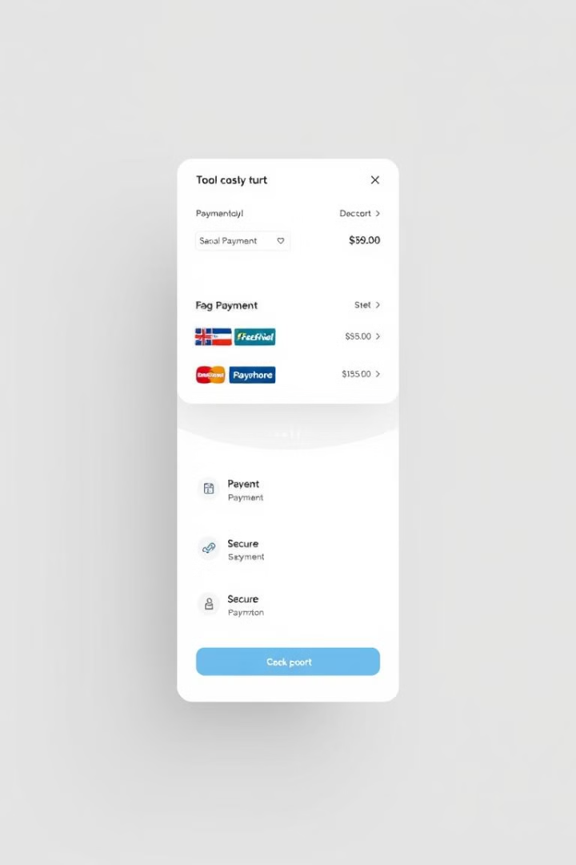
Seamless and Secure Multiple Payment Options
Payment Flexibility
28% of online shoppers abandon carts due to limited payment options.
NextGenTech's Solution
Integration with major credit cards, digital wallets, buy now, pay later services, and cryptocurrency.

Slide 4



Real-Time Parcel Tracking: Know Exactly Where Your Order Is
Integration with major carriers and hyperlocal delivery services.
Proactive SMS and email alerts at every stage of the delivery process.

Slide 5

User-Friendly Interface: Designed for Everyone
1
Streamlined checkout process.
2
Advanced search filters.
3
Customer support chat integrated into every page.

Slide 6
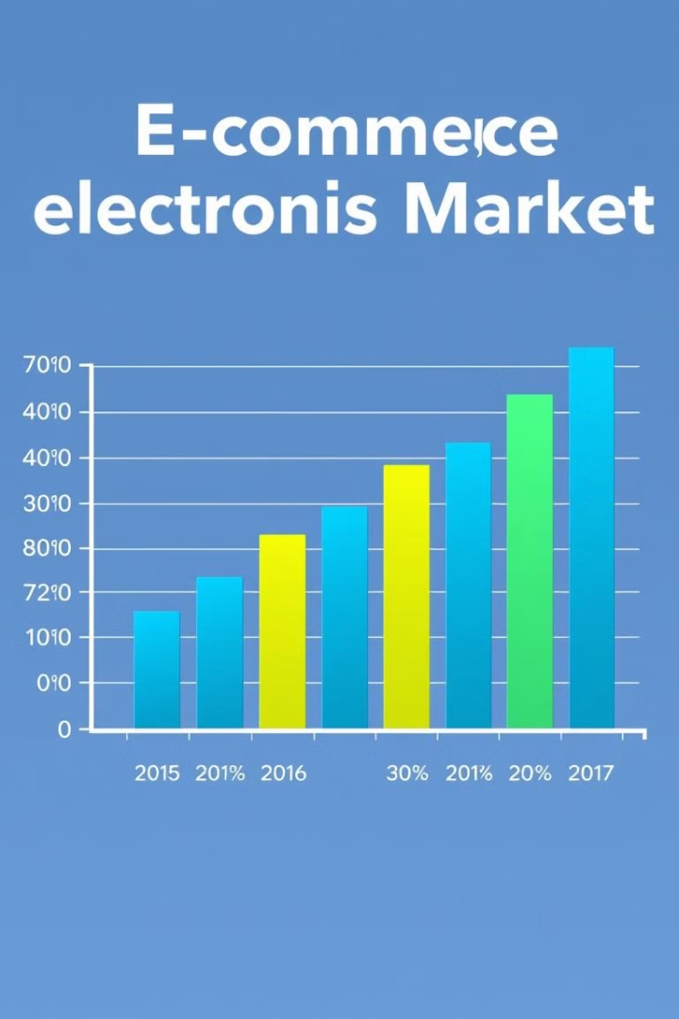


Market Opportunity & Competitive Advantage
Market Size
E-commerce electronics market size: Expected to reach $1.4 trillion by 2027.
Target Audience
Tech-savvy millennials and Gen Z consumers seeking convenience, personalization, and transparency.

Slide 7


Financial Projections & Growth Strategy
Year 1 Target
1
$5 million in sales, acquiring 50,000 active customers.
Growth Rate
2
40% year-over-year for the next 3 years.

Slide 8

NextGenTech: The Future of E-Commerce is Here
Recap of NextGenTech's key features and benefits: AI-powered personalization, secure payment options, real-time tracking, and intuitive user interface. Invest in NextGenTech and be part of the revolution in online electronics shopping.

